Slide 1
Anomaly Detection for Highly Unbalanced Dataset*
Pankaj Mishra
Supervised by : Prof. Gian Luca Foresti
Our Ph.D. is sponsored by external inst. – beanTech srl
DMIF, University of Udine
2018-2019

Slide 2
Problem and Contribution
Problem
Image anomaly detection consists in finding images with anomalous, unusual patterns with respect to a set of normal data. Anomaly detection can be applied to several fields and has numerous practical applications, e.g. in industrial inspection, medical imaging, security enforcement, etc.. However, anomaly detection techniques often still rely on traditional approaches such as one-class Support Vector Machines, while the topic has not been fully developed yet in the context of modern deep learning approaches. Additionally, these processes suffer a lot because of the lack of quality dataset or highly imbalanced dataset.
Contribution
We tried to incorporate the use of deep learning networks to learn the instantiation parameters of the objects in the image and then use it for the classification.
We developed a novel method of anomaly segmentation.
The method has been developed to work on highly imbalanced datasets (which is a general scenario in these cases).

Slide 3
Anomaly Detection
In data mining, anomaly detection (also outlier detection) is the identification of rare items, events or observations which raise suspicions by differing significantly from the majority of the data.
Deep Anomaly Detection
Novelty Detection
Outlier Detection
SCIENTIFIC OUTLINE

Slide 4
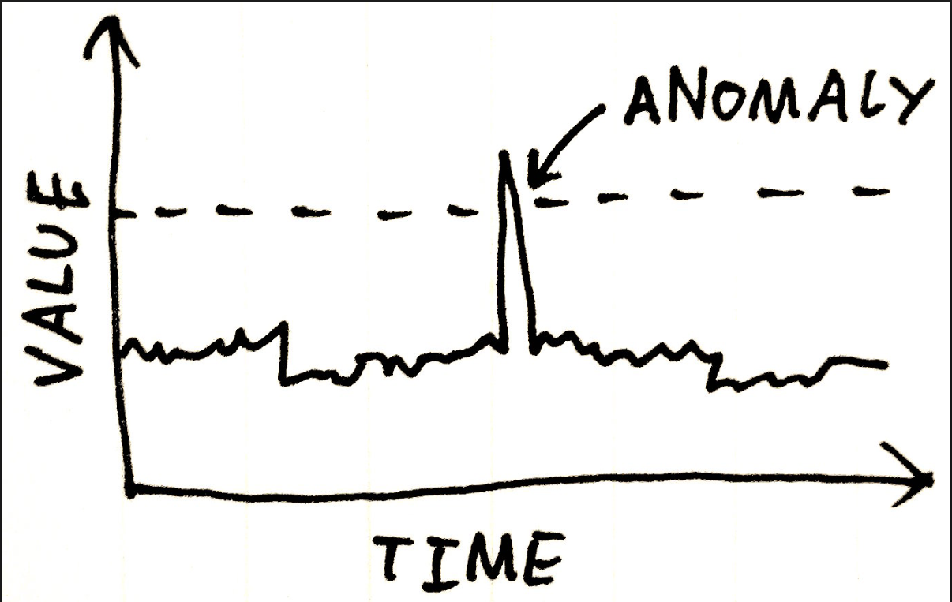
Novelty Detection
Novelty detection is the mechanism by which an intelligent organism is able to identify an incoming sensory pattern as being until now unknown.
This has huge application in bio-medical fields, manufacturing fields, banks and online transactions, trading etc.
SCIENTIFIC OUTLINE

Slide 5

Outlier Detection
an outlier is an observation that diverges from an overall pattern on a sample.
1/19/2020
SCIENTIFIC OUTLINE

Slide 6
In Terms of Learning
Novelty Detection is Semi-supervised Learning
Outlier Detection is Unsupervised Learning
SCIENTIFIC OUTLINE

Slide 7
Challenges with the traditional network and Industries
Vanilla Neural Networks
All the vanilla networks are data hungry models.
Most of the anomaly detection tasks need annotated data.
Availability of High-Imbalanced Dataset which induces biased learning or overfitting
Industrial Challenges
Scarcity of data or standard data because of privacy rules.
Annotation is costly and time consuming
Very high-imbalanced dataset for manufacturing industries
SCIENTIFIC OUTLINE

Slide 8
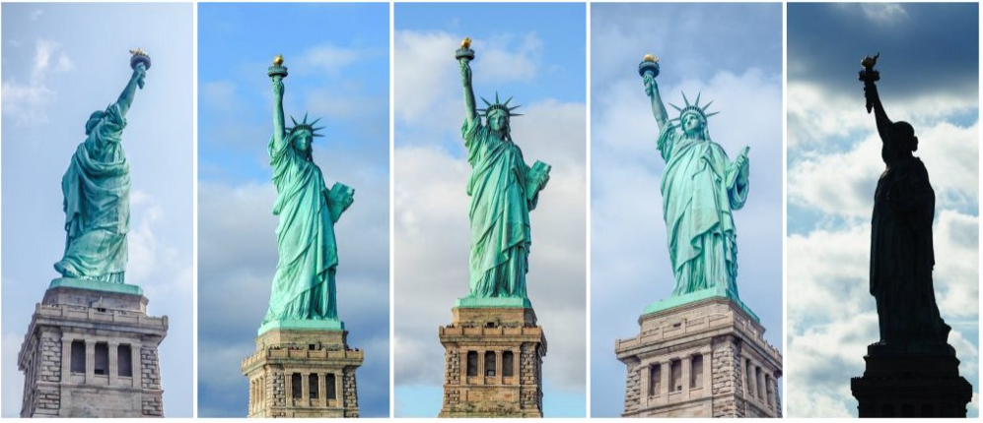
Strength of Capsule Network
Capsule Network preserves the positional variance
Equivariance is better than invariance
Dynamic Routing Algorithm
SCIENTIFIC OUTLINE

Slide 9
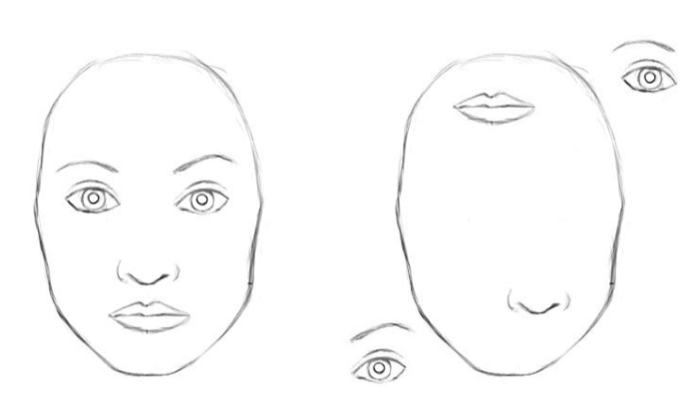
General Working of Capsule Networks
Definition : A capsule is a group of neurons whose activity vector represents the instantiation parameters of a specific type of entity such as an object or an object part
For a normal CNN both of these faces are same
SCIENTIFIC OUTLINE

Slide 10
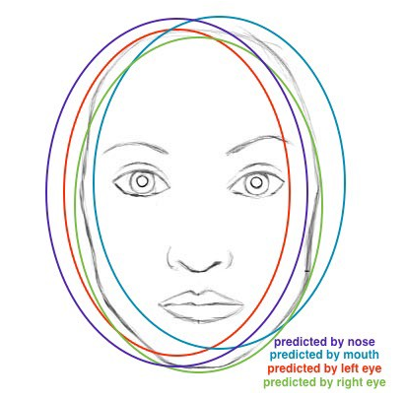
How Capsule Dynamic Routing Algorithm Predicts
Predictions for face location of nose, mouth and eyes capsules closely match: there must be a face there.
Source: author, based on original image.
SCIENTIFIC OUTLINE

Slide 11
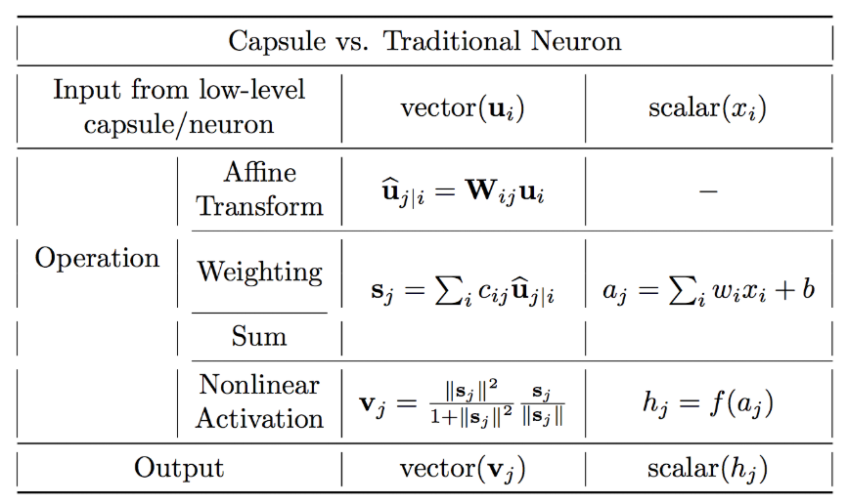
Capsule Vs. Traditional Network
SCIENTIFIC OUTLINE

Slide 12
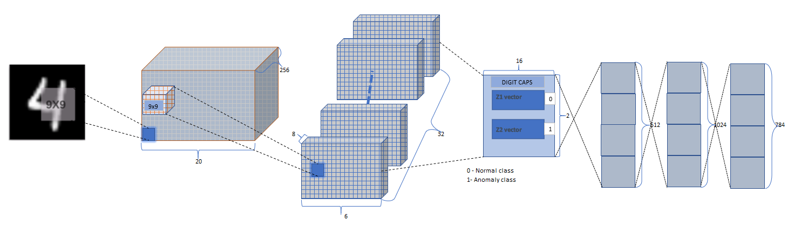
Our Network for Anomaly Detection
Here z1 and z2 are the two classes for normal and anomaly class (a case of supervised learning). But we are doing this for highly unbalanced dataset
ENCODER
DECODER
SCIENTIFIC OUTLINE

Slide 13
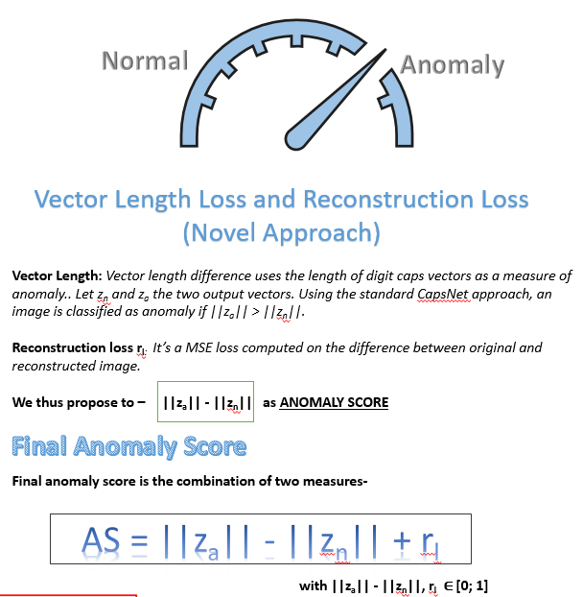
Novel ANOMALY SCORE

Slide 14
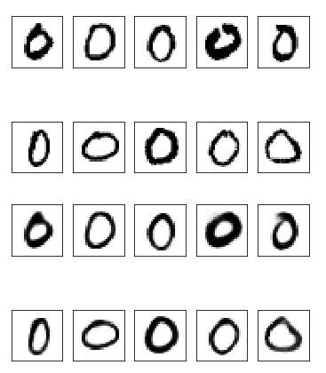
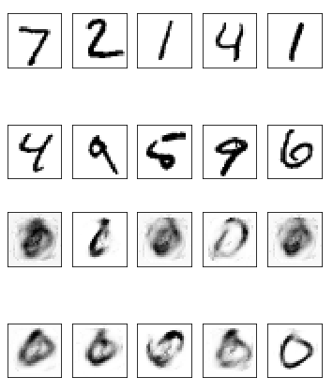
Some Standard Results on Public Dataset
MNIST DATASET
Error | Normal Digits
1% anomaly in training | 0 | 1 | 2 | 3 | 4 | 5 | 6 | 7 | 8 | 9
Total error (logreg on length differences + recon loss) % | 0.50 | 0.73 | 0.78 | 0.79 | 0.90 | 1.67 | 1.26 | 1.95 | 1.00 | 2.07
Normal class
Anomaly class
Reconstruction for Normal class
Reconstruction for Anomaly class

Slide 15
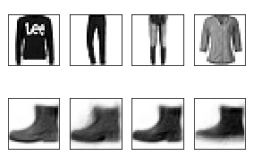
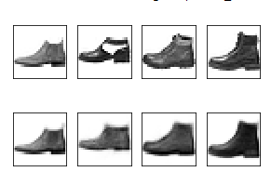
Some Standard Results on Public Dataset
Fashion-MNIST
Error | NORMAL CLASS
Anomaly 1 % | 0 | 1 | 2 | 3 | 4 | 5 | 6 | 7 | 8 | 9
Total error (logreg on length differences + recon loss) | 6.72 | 1.93 | 12.50 | 4.99 | 8.50 | 1.93 | 15.56 | 3.36 | 2.27 | 2.17
Normal class (9)
Anomaly class
Reconstruction for Normal class
Reconstruction for Anomaly class

Slide 16


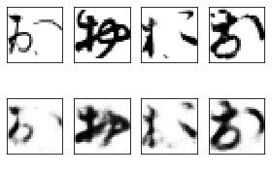
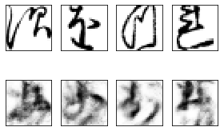
Some Standard Results on Public Dataset
Kuzushiji-MNIST
Normal Classes Image | NORMAL CLASS
Anomaly 1% | 0 | 1 | 2 | 3 | 4 | 5 | 6 | 7 | 8 | 9
Total error (logreg on length differences + recon loss) | 8.40 | 12.06 | 16.85 | 9.14 | 22.92 | 8.40 | 17.24 | 18.68 | 12.85 | 8.55
Normal class ()
Anomaly class
Reconstruction for Normal class
Reconstruction for Anomaly class
SCIENTIFIC OUTLINE

Slide 17
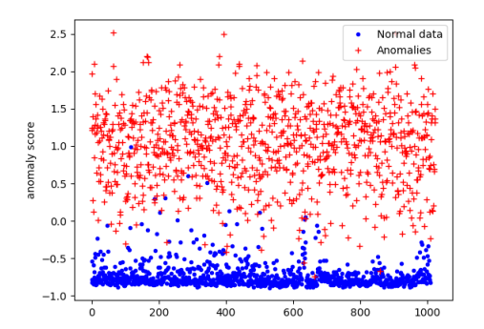
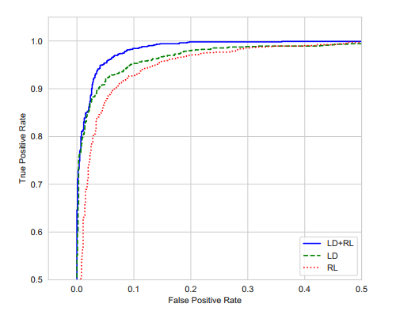
Some Results
Anomaly scores on test data, training done with 10% anomalies.
{b} - ROC curve for three anomaly detection measures: vector length difference, reconstruction loss, and vector length difference + reconstruction loss.

Slide 18
Our Proposed Network shows state of the art results

Slide 19




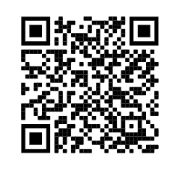
Scan this for published paper
Pankaj Mishra Ph.D. Researcher
Department of Mathematics, Computer Science, and Physics (DMIF)
University of Udine Via Delle Scienze 206, Udine (UD). Italy [UniUd - DMIF, AviReS Lab]
+39-3201434039
mishra.pankaj@spes.uniud.it
https://www.linkedin.com/in/pankaj-mishra-86898140/
https://avires.dimi.uniud.it/

